Slide 1
Turing Machines
Lecture 9
Rowaida AL-Amri

Slide 2
introduction
The "Turing" machine was invented in 1936 by Alan Turing who called it an "a-machine" (automatic machine). The Turing machine is not intended as practical computing technology, but rather as a hypothetical device representing a computing machine. Turing machines help computer scientists understand the limits of mechanical computation.
A Turing machine is a hypothetical device that manipulates symbols on a strip of tape according to a table of rules. Despite its simplicity, a Turing machine can be adapted to simulate the logic of any computer algorithm, and is particularly useful in explaining the functions of a CPU inside a computer.

Slide 3
What is a Turing machine ?
A Turing machine (TM): is a mathematical model of computation proposed by the scientist Alan Turing, and it is considered one of the most powerful fundamental models used in the theory of computation.
It can be considered a more powerful model than:
- Finite Automata (FA)
- Pushdown Automata (PDA)
The main reason is that a Turing machine has an infinite tape on which it can read and write, and it can move the read/write head in both directions.

Slide 4
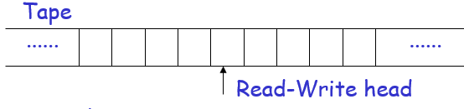
What is a Turing machine ?
. The Basic Idea
A Turing machine works in a manner similar to a simple device that consists of :
A tape for storing data.
A read/write head.
A set of states.
A transition function.
The ability to move left and right along the tape.
Read → Write → Move → Change State

Slide 5
What is a Turing machine ?
DFA can recognize regular languages such as:
L = {w | w contains an even number of 0s}
PDA, on the other hand, can handle languages such as:
L={ a^{n} b^{n} ∣ n≥0 }
A Turing machine, can handle more complex problems, such as:
L={a^{n} b^{n} c^{n} ∣ n≥0}

Slide 6
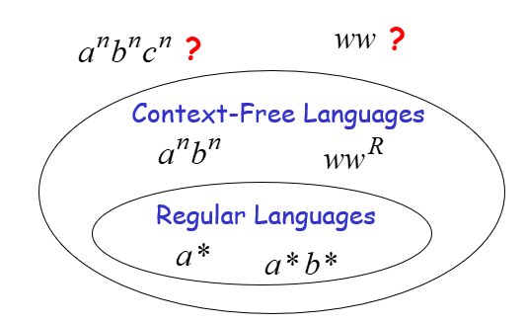
The Language Hierarchy

Slide 7
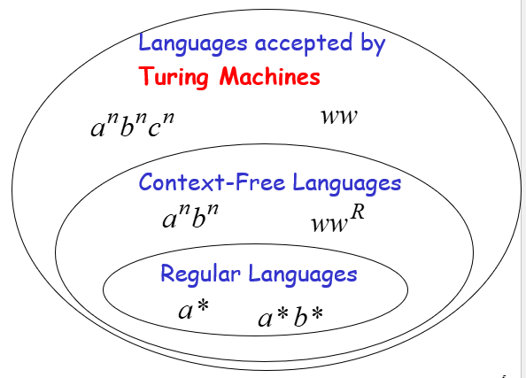

Slide 8
Components of a Turing machine
Tape: A strip divided into cells can be considered the machine's memory.
Read/Write Head: It is the head that reads and writes the symbols.
States: Q={q0​,q1​,q2​,qaccept​,qreject​}
Input: it is the data that is placed on the tape at the start of execution. Exp(aaabbb)
Tape Alphabet
Input Alphabet

Slide 9
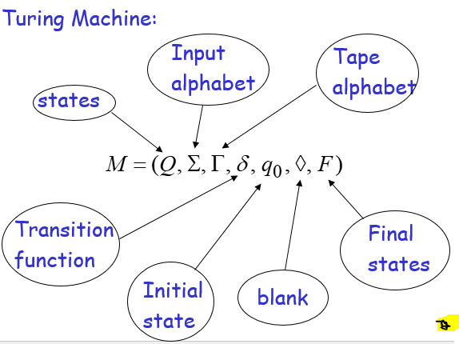
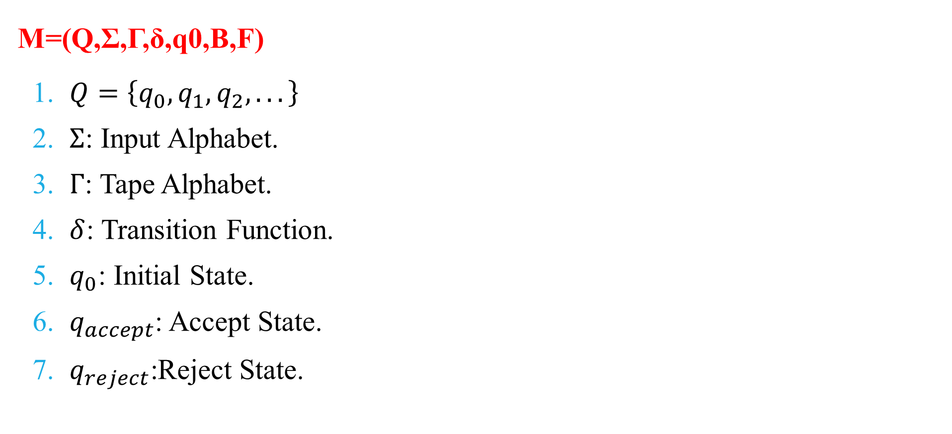
Components of a Turing machine
M=(Q,Σ,Γ,δ,q0​,B,F)
$Q=\left\{q_{0} , q_{1} , q_{2} , ...\right\}$
$Σ$: Input Alphabet.
$Γ$: Tape Alphabet.
$δ$: Transition Function.
$q_{0}$: Initial State.
$q_{accept}$: Accept State.
$q_{reject}$:Reject State.

Slide 10
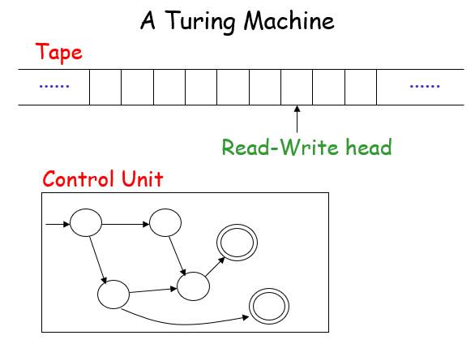

Slide 11
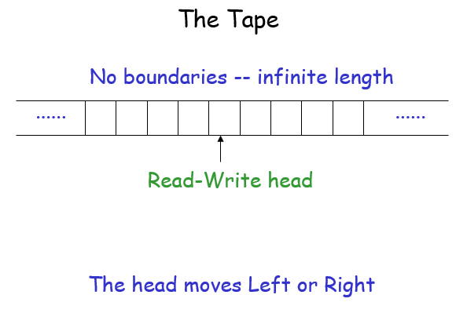

Slide 12
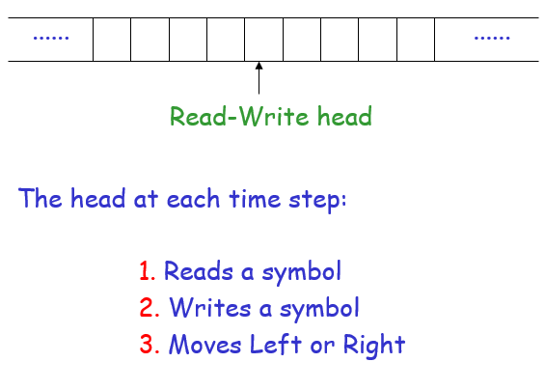

Slide 13
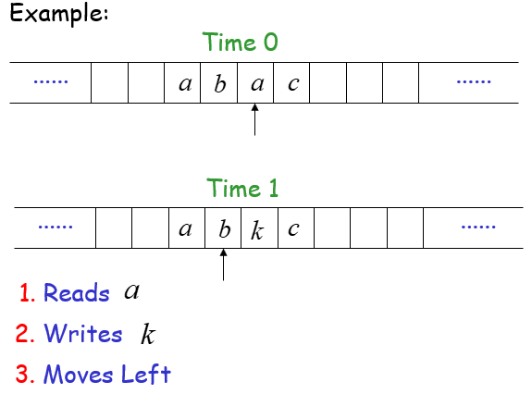

Slide 14
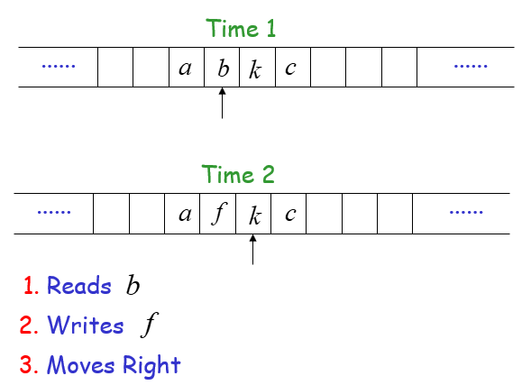

Slide 15
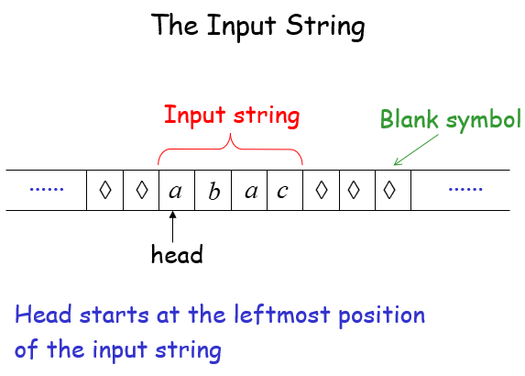

Slide 16
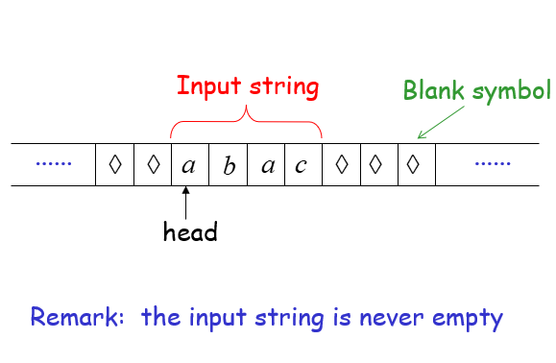

Slide 17
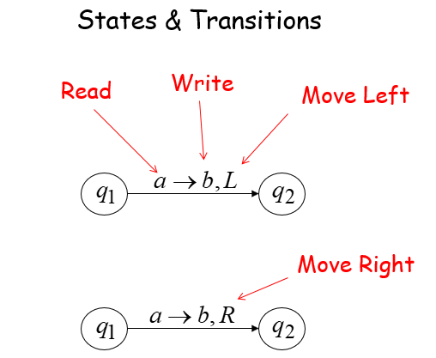

Slide 18



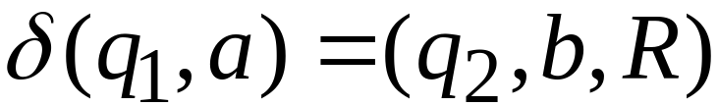

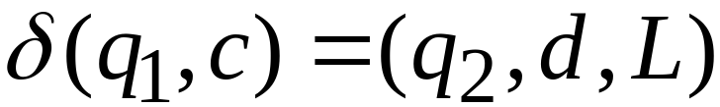
Transition Function:

Slide 19
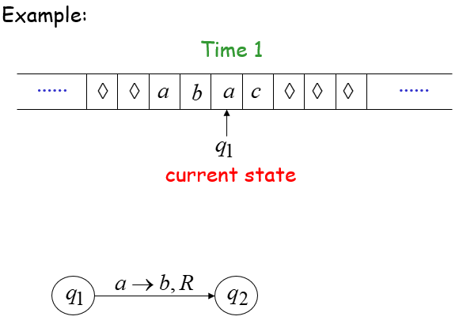

Slide 20
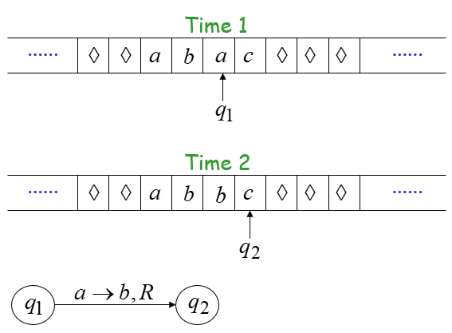

Slide 21
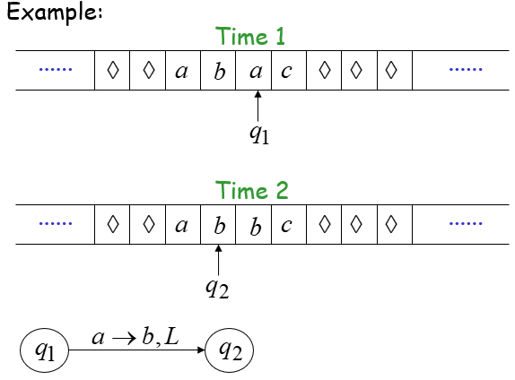

Slide 22
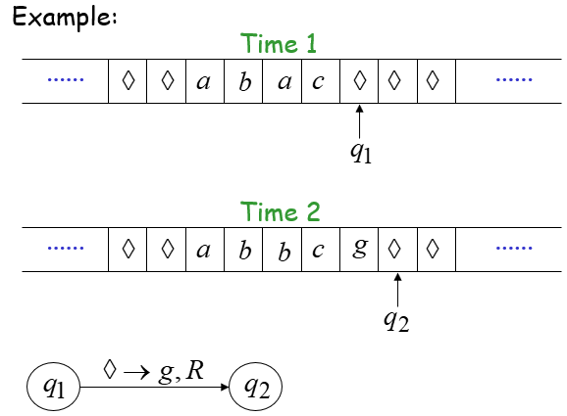

Slide 23
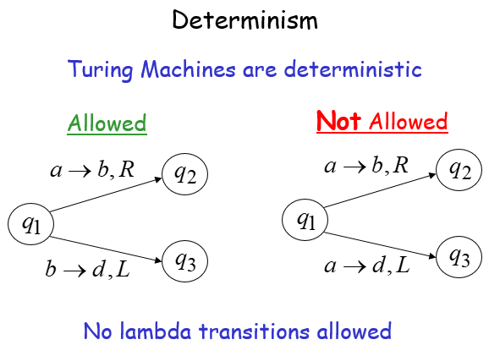
For a read symbol only one transition is allowed
For every state and tape symbol, there must be at most one transition

Slide 24
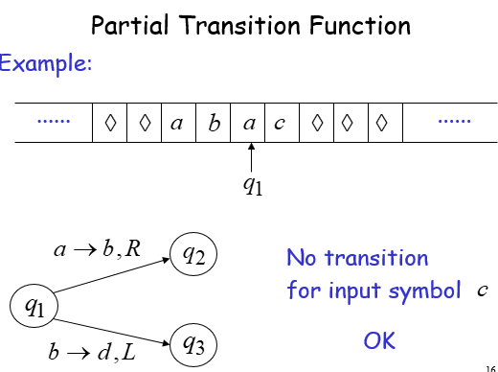

Slide 25
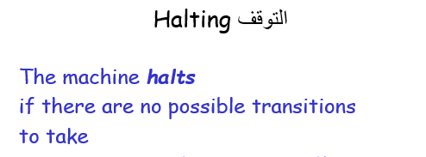

Slide 26
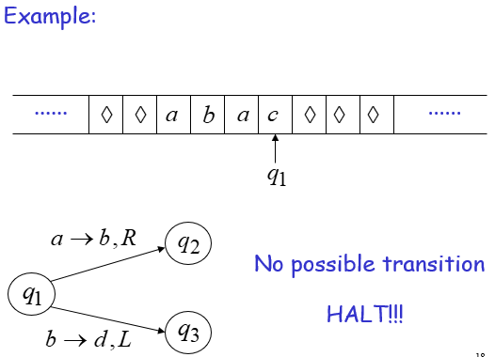

Slide 27
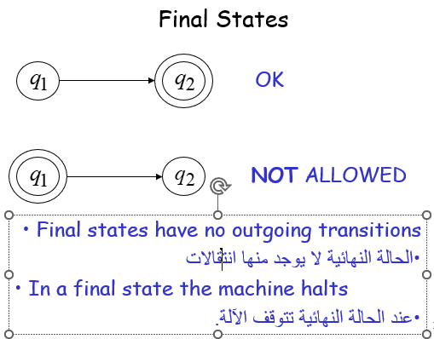

Slide 28
Acceptance
Accept Input
If machine halts
in a final state
If machine halts
in a non-final state
If machine enters
an infinite loop
Reject Input

Slide 29

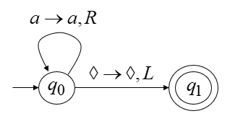
Turing Machine Example
A turing machine for the language

Slide 30



Time 0

Slide 31
Time 0
Time 1

Slide 32
Time 1
Time 2

Slide 33
Time 2
Time 3

Slide 34
Time 3
Time 4
HALT & accept

Slide 35

Rejection Example
Time 0

Slide 36
Time 0
Time 1
HALT & reject

Slide 37
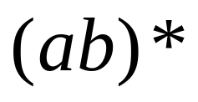
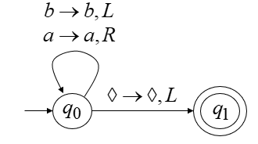
Infinite Loop Example
Turing machine for the language

Slide 38
Time 0

Slide 39
Time 0
Time 1

Slide 40
Time 1
Time 2

Slide 41
Time 2
Time 3
Time 4
Time 5
...Infinite Loop
...Infinite Loop

Slide 42
Because of the infinite loop
the final state cannot be reached
and the input is not accepted.

Slide 43
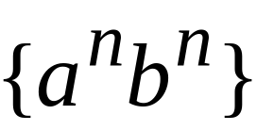
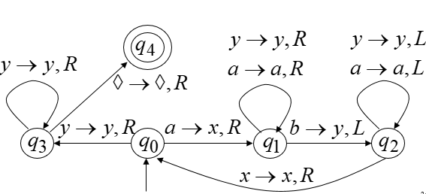
Another Turing Machine Example
Turing machine for the language

Slide 44

Time 0
Time 1

Slide 45
Time 1
Time 2

Slide 46

Time 2
Time 3

Slide 47
Time 3
Time 4

Slide 48
Time 4
Time 5

Slide 49
Time 5
Time 6

Slide 50
Time 6
Time 7

Slide 51
Time 7
Time 8

Slide 52
Time 8
Time 9

Slide 53
Time 9
Time 10

Slide 54

Time 10
Time 11

Slide 55
Time 11
Time 12

Slide 56

Time 12
Time 13
HALT & accept

